Slide 1
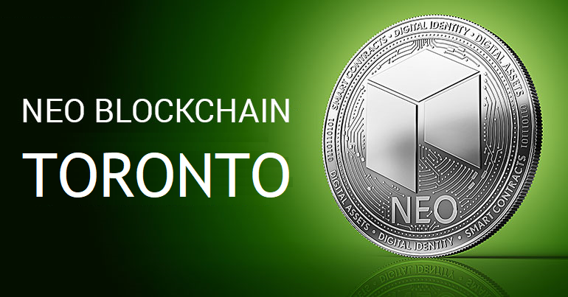
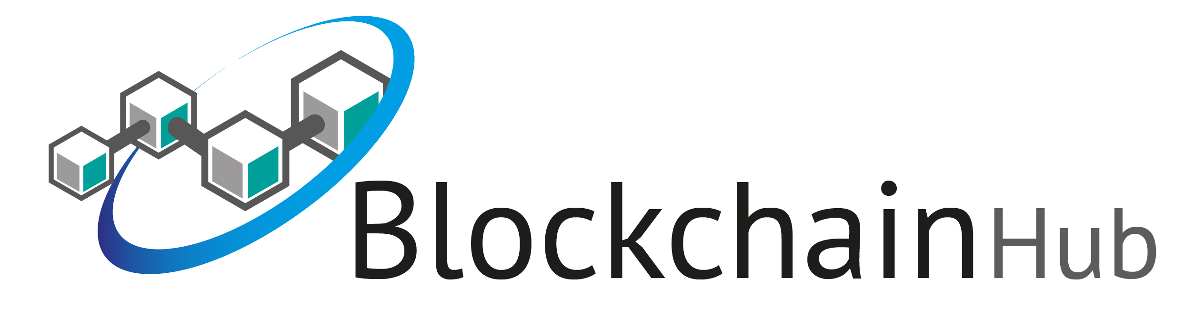
NEO Blockchain TORONTO
Welcome Neoxplorers!
Block 1 Meeting – April 11, 2018
https://www.meetup.com/NEO-Blockchain-Toronto/
neotoronto@outlook.com

Slide 2
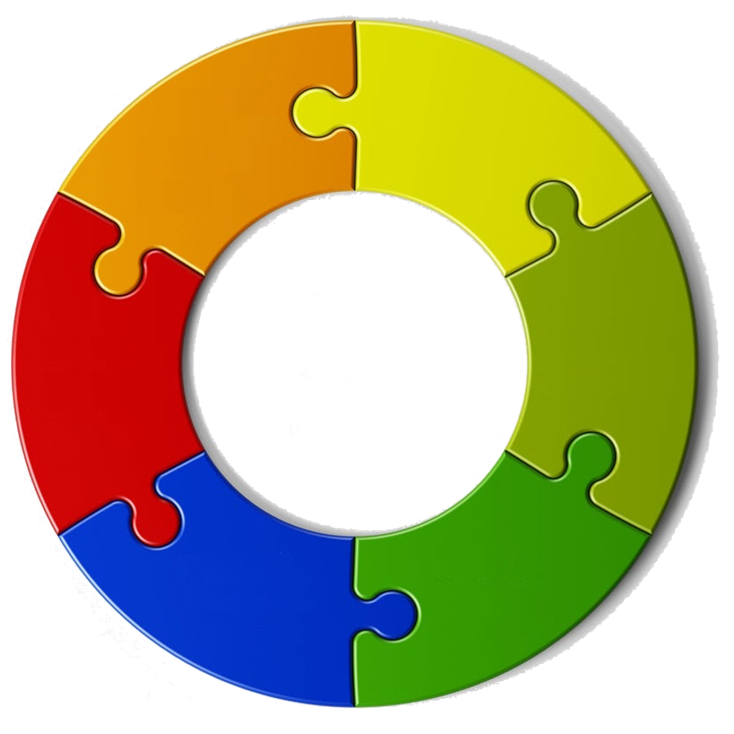

Sponsored by
Tools
Code
NEO
C# Developers
Center of Excellence
neo-csharpcoe
community
Training
Frameworks
Workshops
Best Practices

Slide 3
NEO Themes You’ve Asked About – Thank you!
Distributed Application (dApp) Development
How to start / Start at the beginning / .NET / Python / Skills required
Distributed Applications / Smart Contracts / Practical Guidance
Technical Details / Architecture / Scalability
Future of NEO / NEO Adoption / Disrupting the world
Use cases
Jobs
How is NEO different?
How is it better than the other blockchains / competitive advantages
How does it compare with Ethereum, etc. …
Co-existence with the other blockchains
ETH, Sidechains, Trinity, Interledger, ICON , Qtum, Elastos
NEO ICOs

Slide 4
Agenda
7-8pm for Everyone:
Updates, News, Events
NEO Certified NEO Enterprise Developer (CND) Announcement
Guest speaker: Mathias Leach Glintborg, Global Development Manager, Ontology - "Ontology high-performance public multi-chain project & distributed trust collaboration platform"
Guest speaker: Michael Herman – “The NEO Smart Economy, Smart Processes, and Smart Data”
8-9pm NEO Developer Workshop
Creating and testing NEO smart contracts with Visual Studio and NEO Debugger
Workshop for programming smart contracts with .NET, C# and Visual Studio

Slide 5
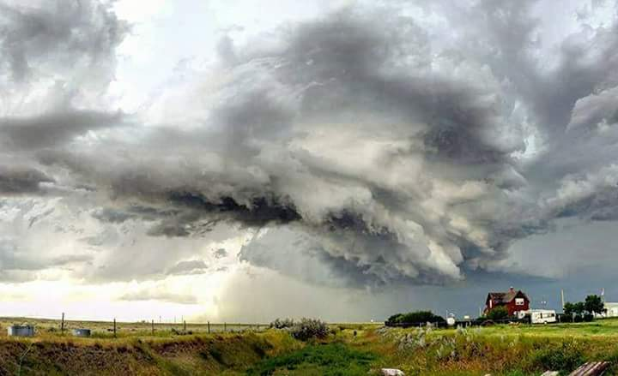

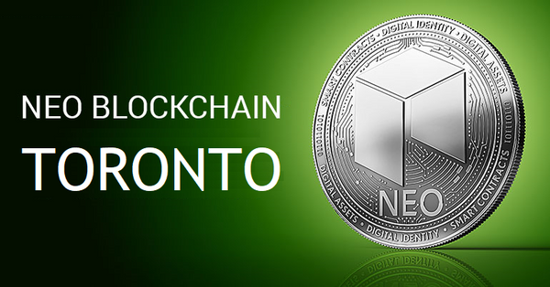
Who is Michael Herman?
Independent Blockchain Developer
I work 14 hours a day on the NEO Blockchain
Experienced Ethereum Developer
I work for myself (and on behalf of my clients)
Decades of software development experience
Developer on very version of Microsoft Windows since the very first
Microsoft, IBM, medium-size companies, small businesses
Curator of NEO C# Developers Center of Excellence community (neo-csharp)
Contributes to several NEO community projects
NEO developer tool suite: neo-debugger and neo-gui-developer projects
NEO Persistable Class Framework (NPC) for efficient object-oriented smart contract development using C#.NEO: mwherman2000/neo-persistibleclasses and neo-npcc2s
NEO Blockchain Quick Start Guide for .NET Developers: mwherman2000/dotnetquickstart
Founder of the first Canadian NEO Blockchain Meetup: NEO Blockchain Toronto

Slide 6
Who are you?
Software Developer/Achitect?
NEO smart contract developers?
Ethereum smart contract developers?
Other blockchain developers?
Microsoft .NET developers? .NET/C#/Visual Studio
Crytopinvestor/trader?
Legal profession?
Financial services (conventional)?
Government?
Banking?
Other sectors?
Students?

Slide 7
What is NEO Blockchain Toronto?
NEO Blockchain Toronto (https://www.meetup.com/NEO-Blockchain-Toronto/) is a non-profit, community-based Meetup group for blockchain developers and architects interested in designing and creating Distributed Ledger Technology (DLT) (aka blockchain) solutions using the NEO Blockchain platform.
We call ourselves Neoxplorers
Meetup second Wednesday evening of each month
May 9, June 13, …
This meetup is a group that it is independent of but supported by the NEO Project (https://github.com/neo-project).
More importantly, NEO Blockchain Toronto is what we want to make it!

Slide 8
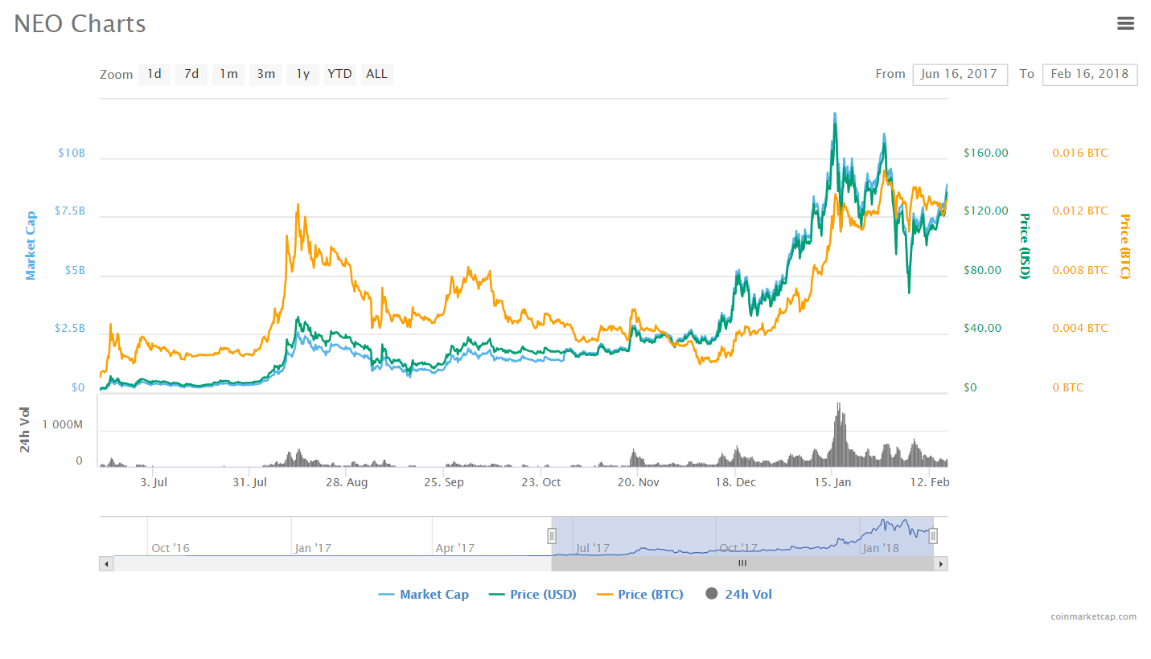
What is NEO?
PROJECT: NEO (https://neo.org/) is a non-profit, community-based blockchain project that utilizes blockchain technology and digital identity to digitize assets, to automate the management of digital assets using smart contracts, and to realize a "smart economy" with a distributed network.
DUAL CRYPTOCURRENCY: $NEO and $GAS
SOFTWARE PLATFORM: 3rd generation distributed applications (dApp) platform
Multiple languages: C# (reference implementation), Python, Java, Golang, JavaScript
First dApp platform suitable for enterprise application development, deployment, and operations
NEO SMART ECONOMY
Key differentiator
GLOBAL COMMUNITY
Discord: https://discord.gg/gqCYeup / https://discord.gg/4TQujHj
NEO C# Developers Center of Excellence (neo-csharpcoe) https://github.com/mwherman2000/neo-csharpcoe/blob/master/README.md
NEL (NewEcoLab) “Chinese-speaking NEO Community” https://github.com/neweconolab
City of Zion “Home of the Open-source Global NEO Developer Community” https://cityofzion.io/

Slide 9
Our Values as Neoxplorers
We operate like the NEO Blockchain
Decentralized
Community based
Consensus driven
Creators of value
Store of value (knowledge)
Transfer of value (training)
Multi-disciplinary
Multi-application
Multi-technology
We behave like the NEO Blockchain
Robust
Reliable
Transparent
Smart
Open
Non-discriminatory
Participatory
Diversity
Committed

Slide 10
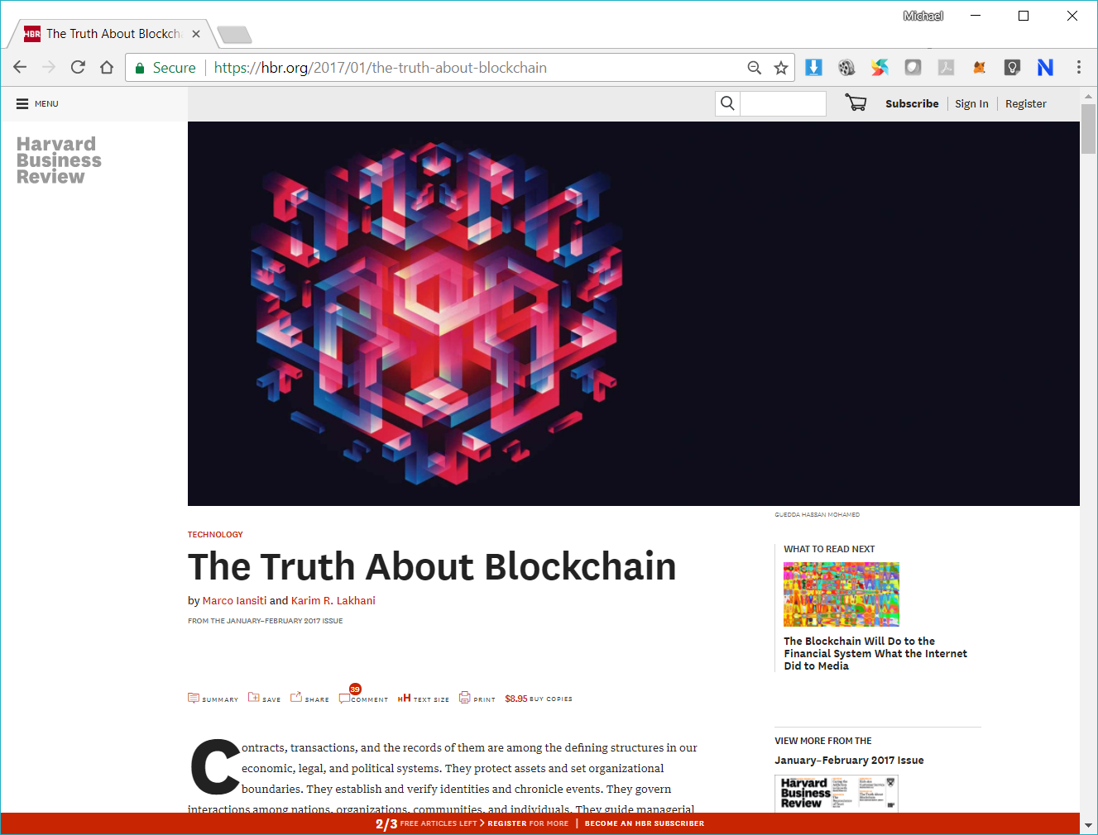

Slide 11
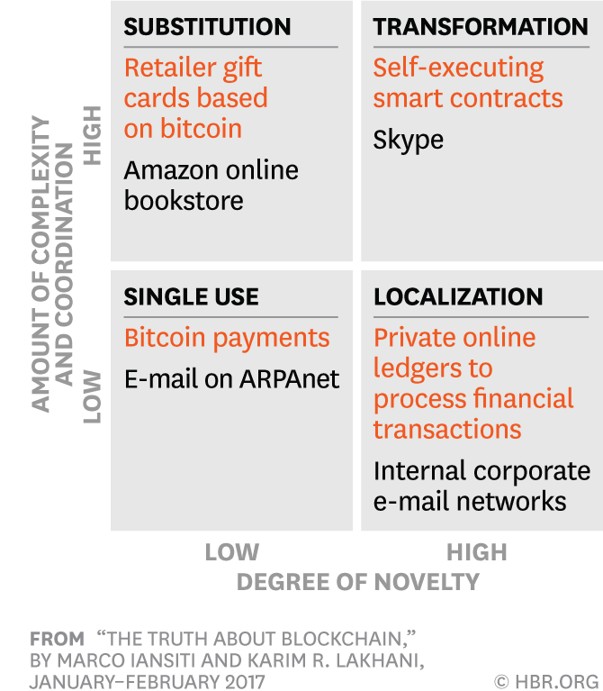
Blockchain is a Foundational Technology
Blockchain is not a disruptive technology
Blockchain is a foundational technology
Doesn’t attack a traditional business model with a lower-cost solution and overtake incumbent firms quickly
Lays new foundations for new economic and social systems
Foundational technologies (likes TCP/IP) take decades to seep into and integrate with our economic and social infrastructure
The process of adoption is gradual and steady
AMOUNT OF COMPLEXITY AND COORDINATION
DEGREE OF NOVELTY
Notes:
Foundation Technology vs. Disruptive Technology
Single use.
In the first quadrant are low-novelty and low-coordination applications that create better, less costly, highly focused solutions. E-mail, a cheap alternative to phone calls, faxes, and snail mail, was a single-use application for TCP/IP (even though its value rose with the number of users). Bitcoin, too, falls into this quadrant. Even in its early days, bitcoin offered immediate value to the few people who used it simply as an alternative payment method.
Localization.
The second quadrant comprises innovations that are relatively high in novelty but need only a limited number of users to create immediate value, so it’s still relatively easy to promote their adoption. If blockchain follows the path network technologies took in business, we can expect blockchain innovations to build on single-use applications to create local private networks on which multiple organizations are connected through a distributed ledger.
Substitution.
The third quadrant contains applications that are relatively low in novelty because they build on existing single-use and localized applications, but are high in coordination needs because they involve broader and increasingly public uses. These innovations aim to replace entire ways of doing business. They face high barriers to adoption, however; not only do they require more coordination but the processes they hope to replace may be full-blown and deeply embedded within organizations and institutions. Examples of substitutes include cryptocurrencies—new, fully formed currency systems that have grown out of the simple bitcoin payment technology. The critical difference is that a cryptocurrency requires every party that does monetary transactions to adopt it, challenging governments and institutions that have long handled and overseen such transactions. Consumers also have to change their behavior and understand how to implement the new functional capability of the cryptocurrency.
Transformation.
Into the last quadrant fall completely novel applications that, if successful, could change the very nature of economic, social, and political systems. They involve coordinating the activity of many actors and gaining institutional agreement on standards and processes. Their adoption will require major social, legal, and political change.

Slide 12
2. NEO Whitepaper
“NEO is the use of blockchain technology and digital identity to digitize assets, the use of smart contracts for digital assets to be self-managed, to achieve [a] “smart economy” with a distributed network.”

Slide 13
NEO Technology/Implementation: Consensus Mechanism Delegated Byzantine Fault Tolerance (dBFT)
“In the NEO dBFT consensus mechanism, taking about 15 to 20 seconds to generate a block, the transaction throughput is measured up to about 1,000TPS, which is excellent performance among the public chains.”
“Through appropriate optimization, there is potential to reach 10,000TPS, allowing it to support large-scale commercial applications.”
“The dBFT combines digital identity technology, meaning the bookkeepers can be a real name of the individual or institution.”
“Thus, it is possible to freeze, revoke, inherit, retrieve, and ownership transfer due to judicial decisions on them.”
“This facilitates the registration of compliant financial assets in the NEO network. The NEO network plans to support such operations when necessary.”

Slide 14
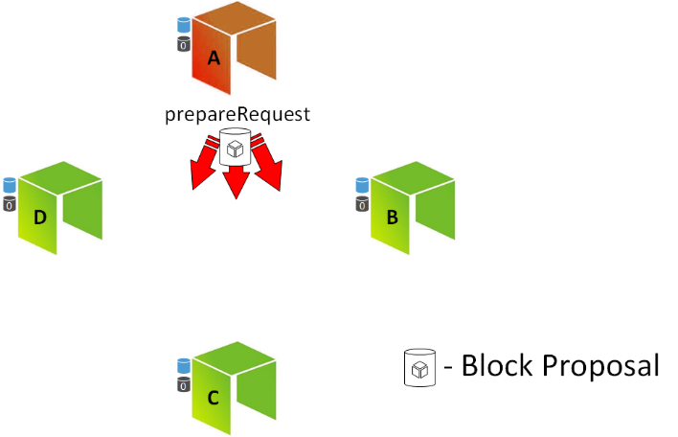
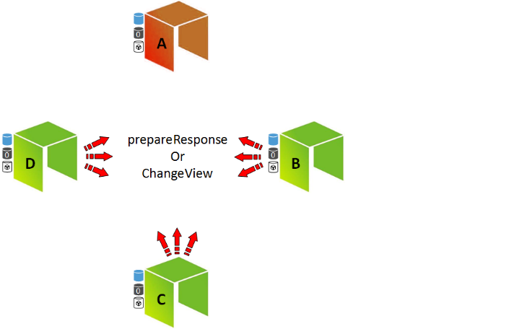
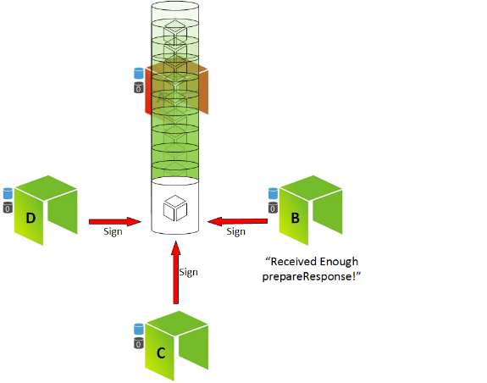
Delegated Byzantine Fault Tolerance (dBFT) NEO Consensus Mechanism
NEO: There is no competition to create the next block (e.g. no miners, no PoW)
NEO: There is no betting or staking to choose the next block (e.g. no PoS)
NEO: Consensus nodes are voted in as representatives to choose the next block
NEO: No reward for your own node to be selected

Slide 15
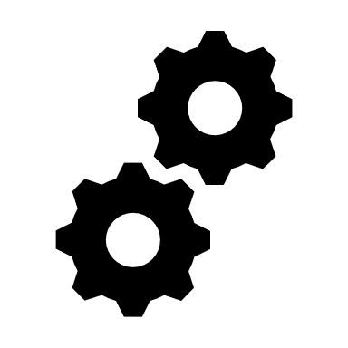
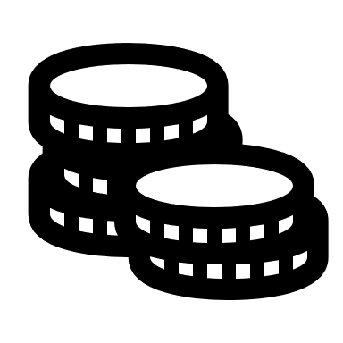


Problems with Proof of Work and Proof of Stake
1. Proof of Work (PoW)
2. Proof of Stake (PoS)

Slide 16
PoW and PoS compared to dBFT
Consensus algorithm: PoW and PoS
Consensus algorithm: dBFT
One and only one branch

Slide 17
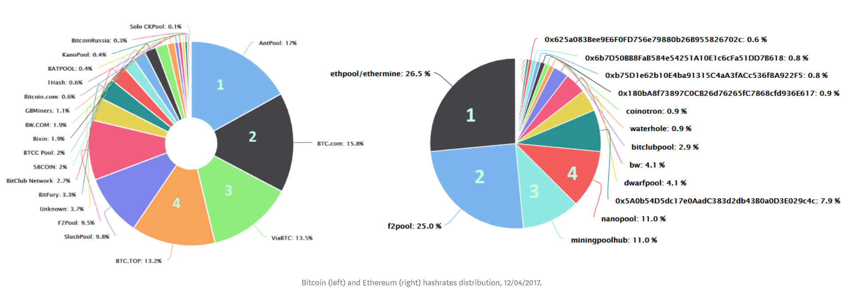
How decentralized are the BTC and ETH networks?
Coopetition: A New Approach to Decentralization https://medium.com/proof-of-working/decentralization-from-coopetition-b10d7ce3b9d

Slide 18
4. Why NEO?

Slide 19
NEO was created for Large Scale dApps*
Mainchain speeds
NEO 1000 – 10,000 TPS (single core)
BTC 3 – 4 TPS
ETH 10 – 20 TPS
No transaction fees Initial 10 GAS fee is for free. Simple Smart Contracts can be run for free.
More freedom for application developers to choose the business model that most suits to their business. Service and usage fees can be charged in any way off-chain.
Confirmations needed
NEO 1 and only 1
BTC 6+
ETH 20+
*dApps – Distributed Apps
NEO Persistable Classes make Enterprise App Development real

Slide 20
6. NEO Events

Slide 21
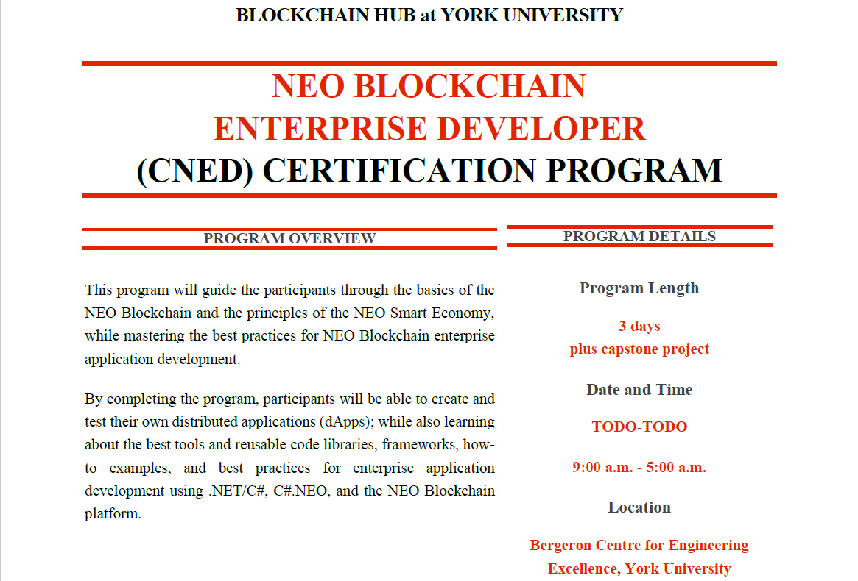

Slide 22

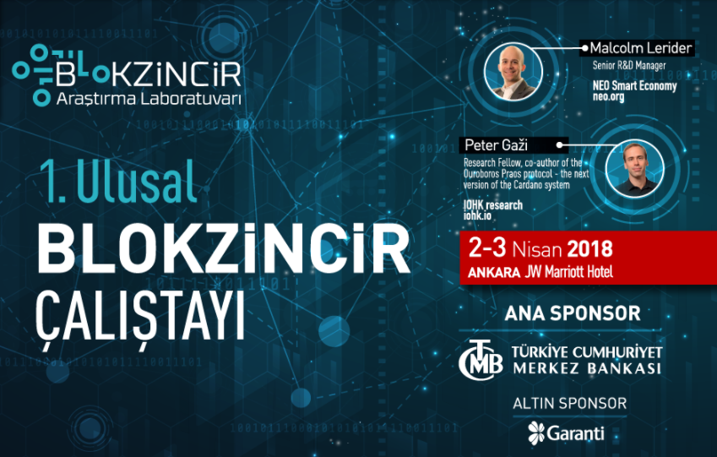
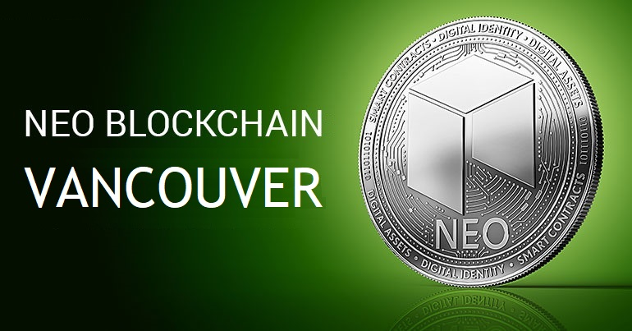
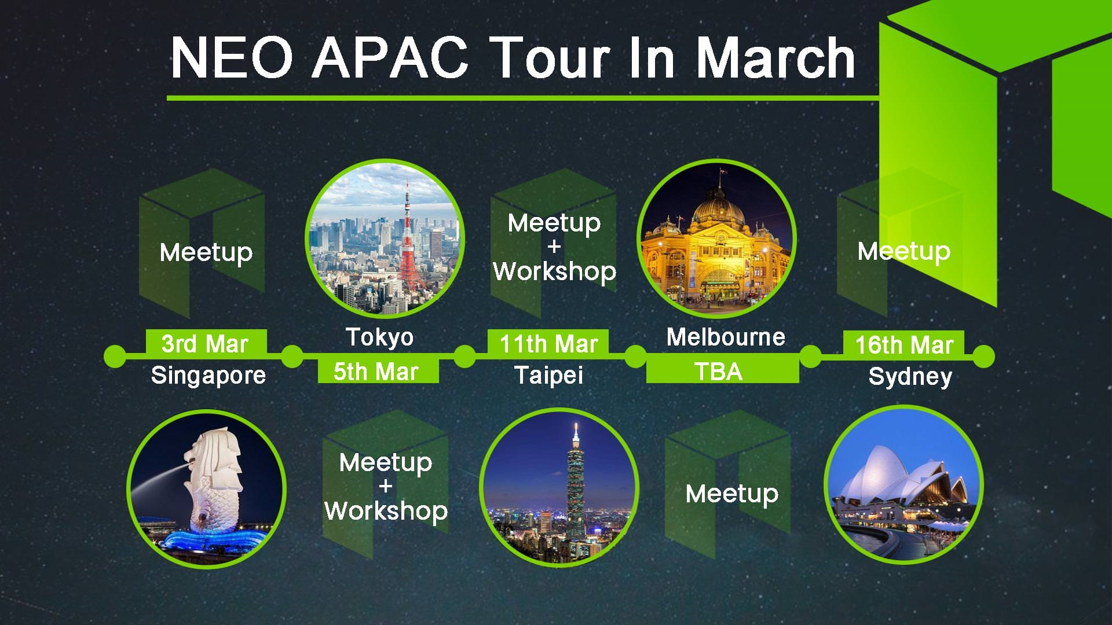
NEO Events - Past
Second Wednesday evening of each month
Second Thursday evening of each month

Slide 23
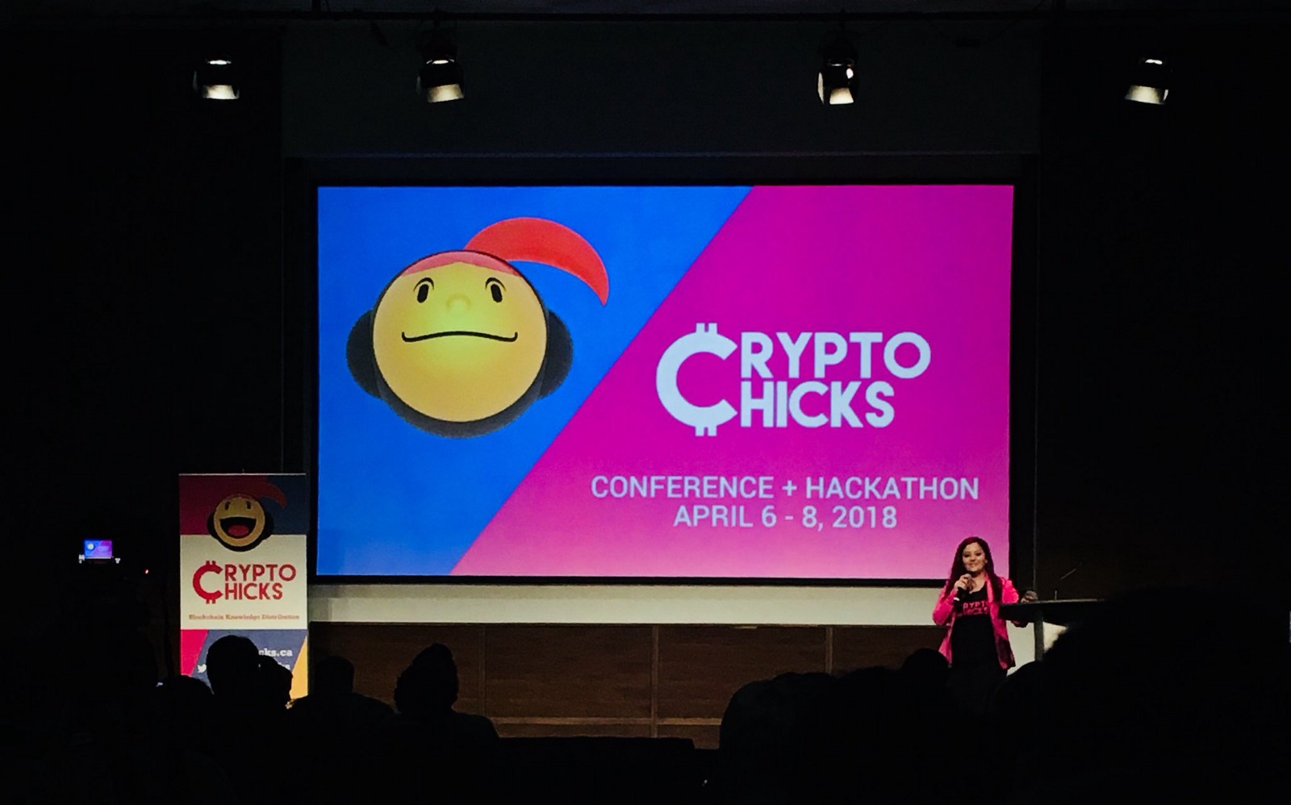
NEO Events - Past
100+ women (and men)

Slide 24
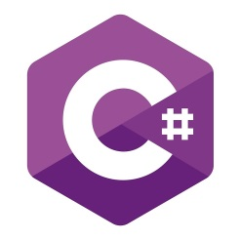
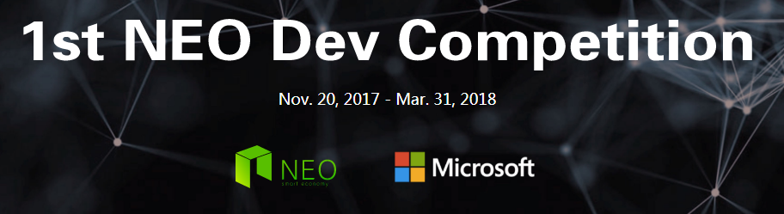
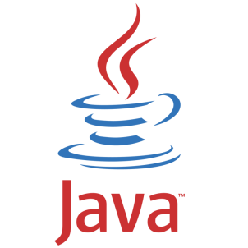

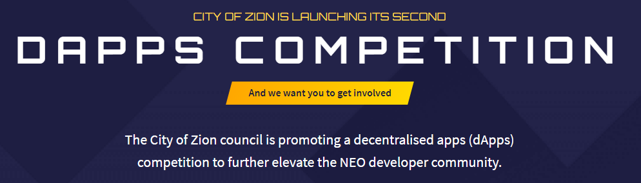

NEO dApp Competitions USD$490K in prizes

Slide 25
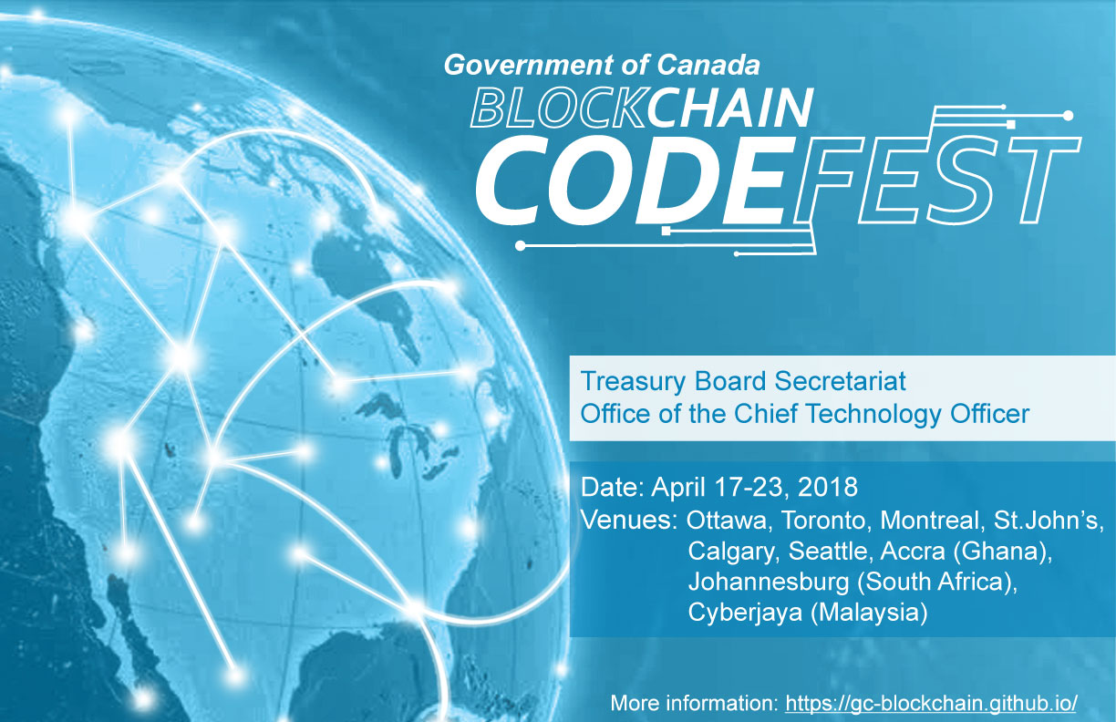
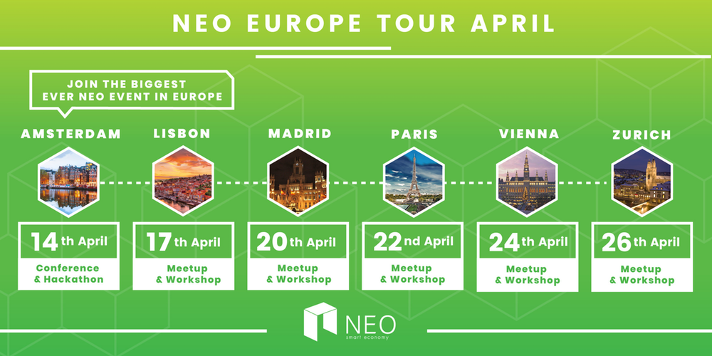
Events - Upcoming
Wednesday - June 13
Next Week – April 17-23

Slide 26
7. Resources

Slide 27
NEO Blockchain C# Developers Center of Excellence https://github.com/mwherman2000/neo-csharpcoe
Founder: Michael Herman (neotoronto@outlook.com)
NEO Blockchain end-to-end, detailed guidance for .NET developers
Content purposely designed to help .NET developers ramp up and become productive more quickly
Repository for content presented at the NEO Blockchain Toronto meetup group
Contents
NEO Blockchain Quick Start Guide for .NET Developers https://github.com/mwherman2000/neo-dotnetquickstart
NEO Blockchain Architecture Reference Model (ARM) for .NET Developers (neo-charm) https://github.com/mwherman2000/neo-charm
NEO Blockchain Toronto https://github.com/mwherman2000/neo-windocs/tree/master/events/2018-neo-blockchain-toronto

Slide 28
NEO Blockchain Quick Start Guide for .NET Developers https://github.com/mwherman2000/neo-dotnetquickstart/blob/master/README.md
Pre-requisites and Recommendations
Download and install Visual Studio 2017 Community Edition integrated development environment (IDE)
Download and unpack NEO developer tool projects (source)
Coffee time: Wait for previous activities to complete
Install NeoContractPlugin Visual Studio extension
Build and test NEO developer tool projects (from source)
Download, install, and test Docker platform
Download and test NEO privatenet Docker container
Create and compile HelloWorld smart contract sample
Deploy and test the HelloWorld smart contract
Celebrate
Appendix A - Checklist
Appendix B - Roadmap
Appendix C - Reset NEO privatenet Environment: Container, Wallets, and Clients
Statistics
10 activities comprising 130 documented tasks (approximately)
140 screen shots (approximately)
7 batch files
2 JSON configuration files
1 C# code snippet

Slide 29
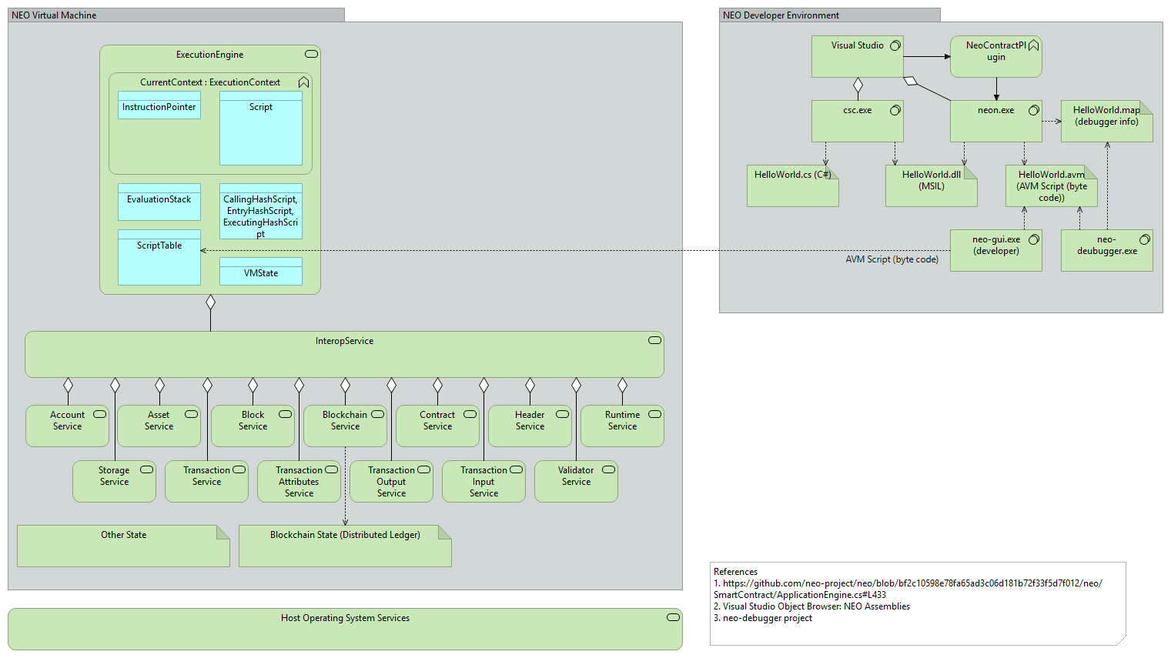
NEO Blockchain Architecture Reference Model (ARM) for .NET Developers (neo-charm) https://github.com/mwherman2000/neo-charm/blob/master/README.md

Slide 30
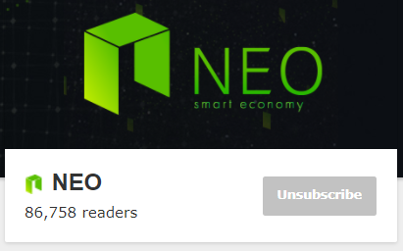
NEO Resources: Videos and Webcasts
The New Vision - Da Hongfei https://www.youtube.com/watch?v=th7jZlmoZBc
Malcolm Lerider: Clarification on NEO, GAS and Consensus Nodes https://www.youtube.com/watch?v=iV4WREWtCiI
A Deep Dive into NeoVM & NeoContract [English Subtitles] https://www.youtube.com/watch?v=fLppte-guYE
NEO Persistable Classes (NPC) e-dApp Smart Contract Platform 2.0: Deep Dive https://www.youtube.com/watch?v=Nj4-m2o94VE
NEO – Reddit https://www.reddit.com/r/NEO/

Slide 31
NEO Resources: NEO DevCon 1, January 2018
The New Vision - Da Hongfei | NEO DevCon 1 https://www.youtube.com/watch?v=th7jZlmoZBc
Opening Address - Scott Hunter, Microsoft | NEO DevCon 1 https://www.youtube.com/watch?v=ZFsu5HPU2xM
Ontology, The Technical Vision of Distributed Trust Networks | NEO DevCon 1 https://www.youtube.com/watch?v=QyaZz0vtONs
Imusify, Decentralized Platform for Music Related Digital Content | NEO DevCon 1 https://www.youtube.com/watch?v=dgmfO8nKJkE
NeoAuth, Login Using the NEO Blockchain | NEO DevCon 1 https://www.youtube.com/watch?v=F7teukbcbIg
Phantasma, User-Owned Content | NEO DevCon 1 https://www.youtube.com/watch?v=cinexz6gjsU
NEO•ONE, Development Framework | NEO DevCon 1 https://www.youtube.com/watch?v=yWzjNhiZFmA
THEKEY, A Decentralized Ecosystem of An Identity Verification Tool | NEO DevCon 1 https://www.youtube.com/watch?v=St-UW0lPB7o
NEO’s Global Vision and the Evolving Regulatory Environment - Miles Graham | NEO DevCon 1 https://www.youtube.com/watch?v=FidRGNeab3I
NEX, Decentralized Exchanges | NEO DevCon 1 https://www.youtube.com/watch?v=1005ed20e0Q

Slide 32
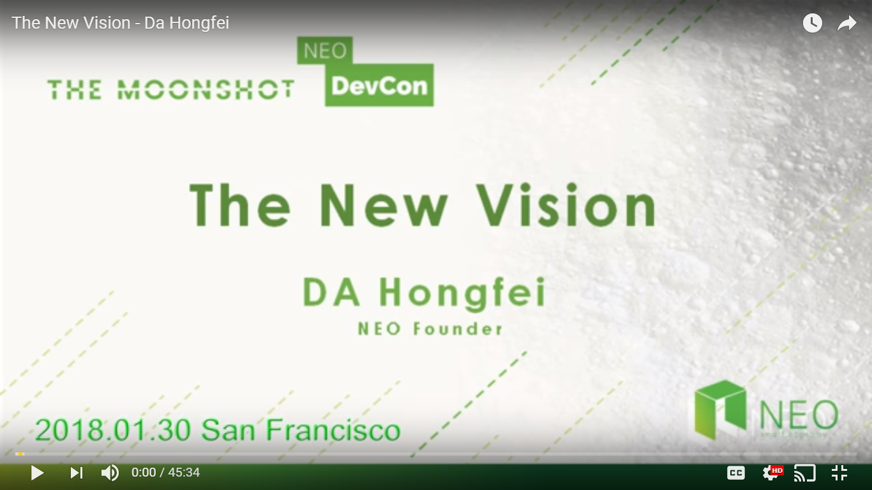
NEO Resources
General
NEO.org http://neo.org
NEO Tutorials (C#, Java, Python), API docs http://docs.neo.org
NEO DevCon “Th New Vision” Keynote by NEO Founder https://www.youtube.com/watch?time_continue=3&v=th7jZlmoZBc
Developers
N NEO C# Developers Center of Excellence (neo-csharpcoe) https://github.com/mwherman2000/neo-csharpcoe/blob/master/README.md
Discord NEO Community (like Slack) https://discord.gg/gqCYeup
The NEO Project https://github.com/neo-project
City of Zion awesome-neo project: Developer Docs https://github.com/CityOfZion/awesome-neo/ #developer-documentation

Slide 33
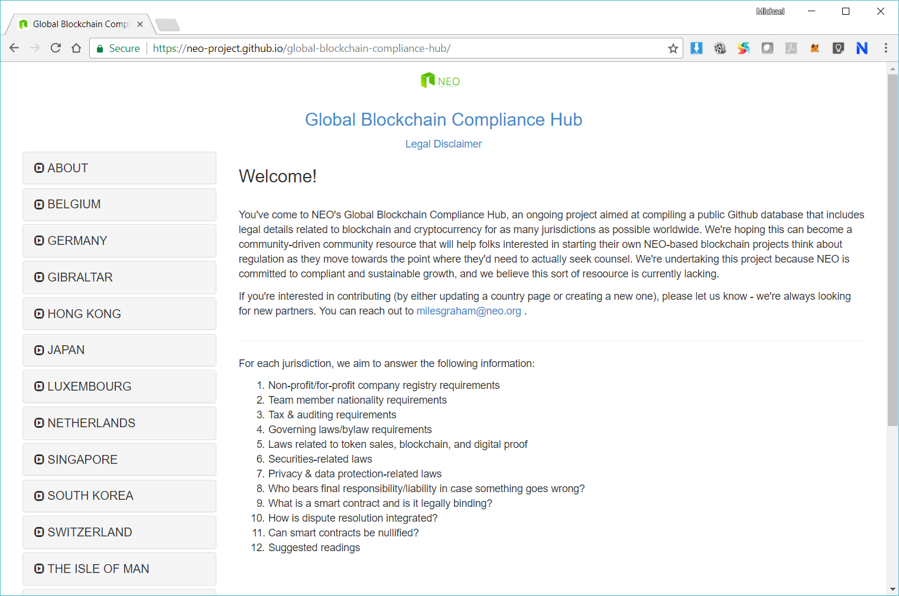

Slide 34
8. Next Steps

Slide 35
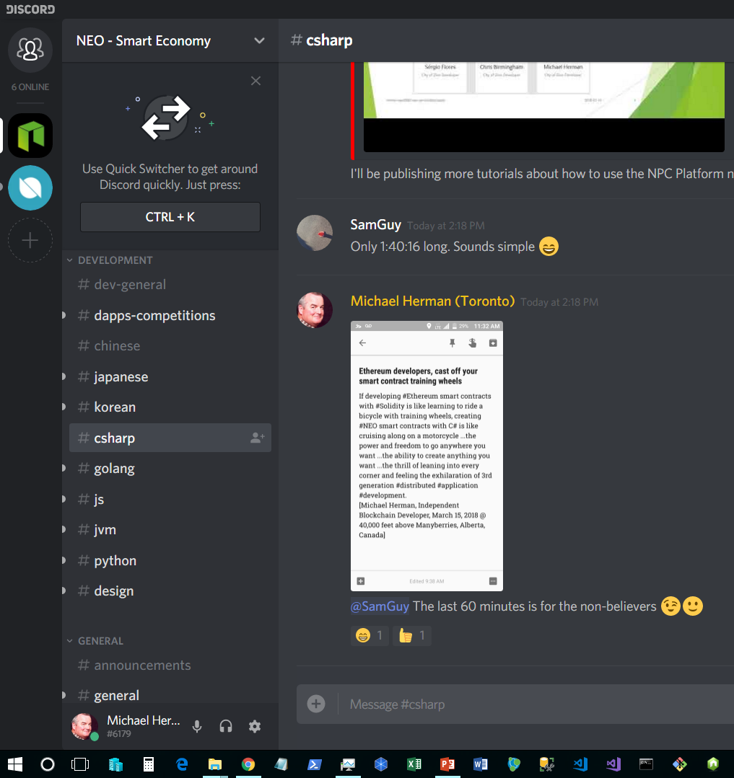
Next Steps
Join Discord https://discord.gg/gqCYeup / https://discord.gg/4TQujHj
Read through and contribute to NEO C# Developers Center of Excellence (neo-csharpcoe) https://github.com/mwherman2000/neo-csharpcoe/blob/master/README.md
Start with NEO Blockchain Quick Start Guide for .NET Developers https://github.com/mwherman2000/neo-dotnetquickstart/blob/master/README.md

Slide 36
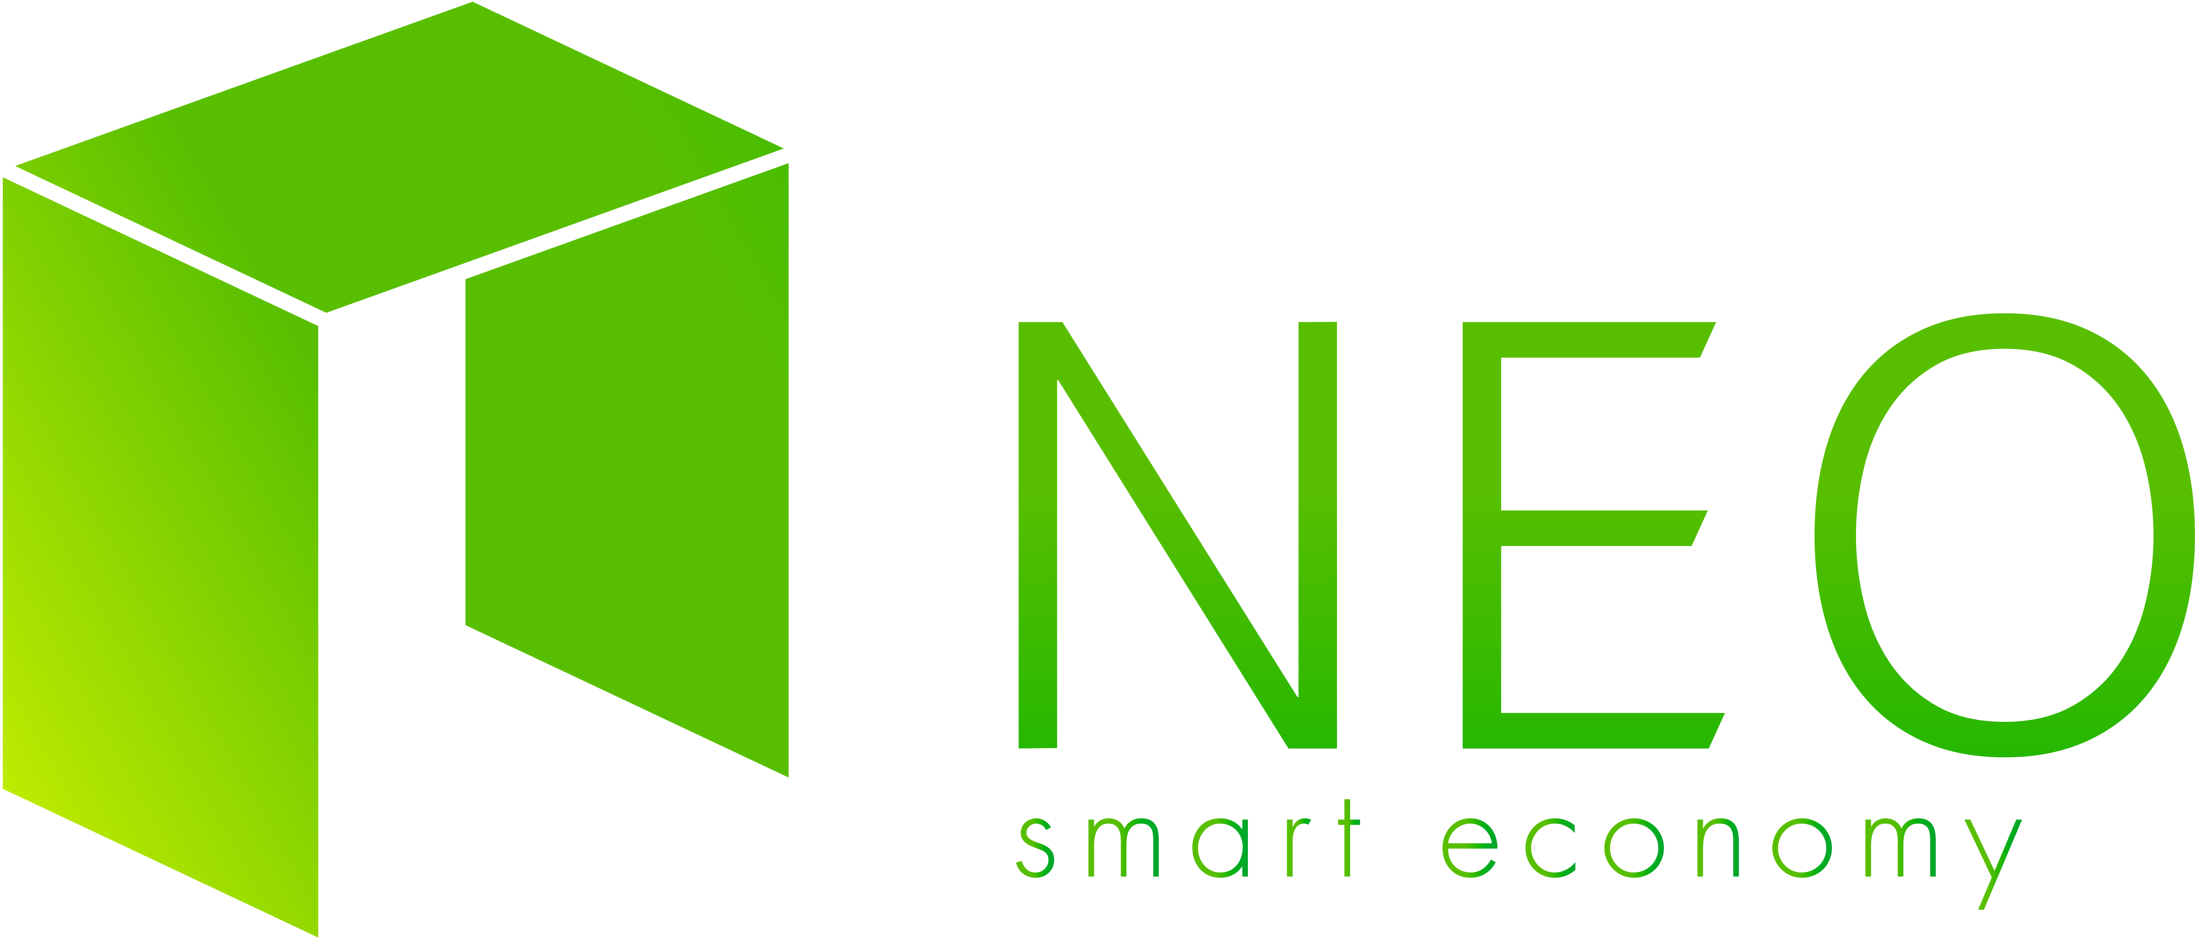
Questions?
Thank you for coming out this evening

Slide 37
Backup Slides

